Slide 1

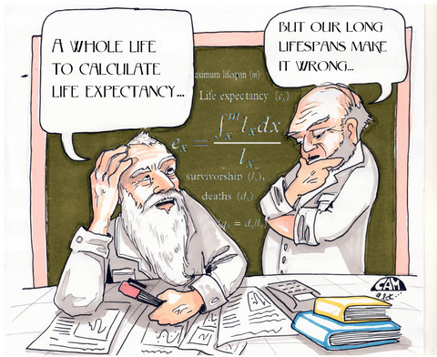
WHAT MAKES A COUNTRY LIVE LONGER?
ISYE 6414 – Regression Analysis
TEAM 15:
Manvitha Kalicheti - 903838438
Nivedita Mahesh - 903833708
Shivam Pancholi - 903817197
Nasar Patel - 903821532
Priyank Shukla - 903821694

Slide 2

PROBLEM DESCRIPTION
We aim to understand which factors influence the Life Expectancy (Response) in a country.
The problem involves finding the best fit regression model to estimate life expectancy for different countries.
Factors influencing the Life Expectancy in a country (Predictors):
Social
Health
Financial
Population
Mortality Rate
Immunization

Slide 3



DATA SOURCES
Data sources:
We consider data for the year 2014.
Sample Size : 183 countries
Variables:
1 target (Life Expectancy)
1 non predictor (Country)
18 predictor variables (1 qualitative and 17 quantitative)
Training set : We used 163 countries to build and train our linear model
Test set : We tested the model on the remaining 20 countries

Slide 4
PLAYING WITH THE DATA!
Data cleaning
Dealing with multicollinearity
Variable Selection
ANOVA – Model Selection
Prediction on Test Data
Final Model Interpretation
Residual analysis
Identifying Outliers

Slide 5
EXPLORATORY ANALYSIS – CLEANING DATA
No. of data points:
183 countries
Missing data:
2014 over 2015, looked up missing data (Wikipedia, World Bank) manually.
Off-seeming data:
Population, GDP (replaced completely with World Bank Data)
Split:
90% train, 10% test

Slide 6
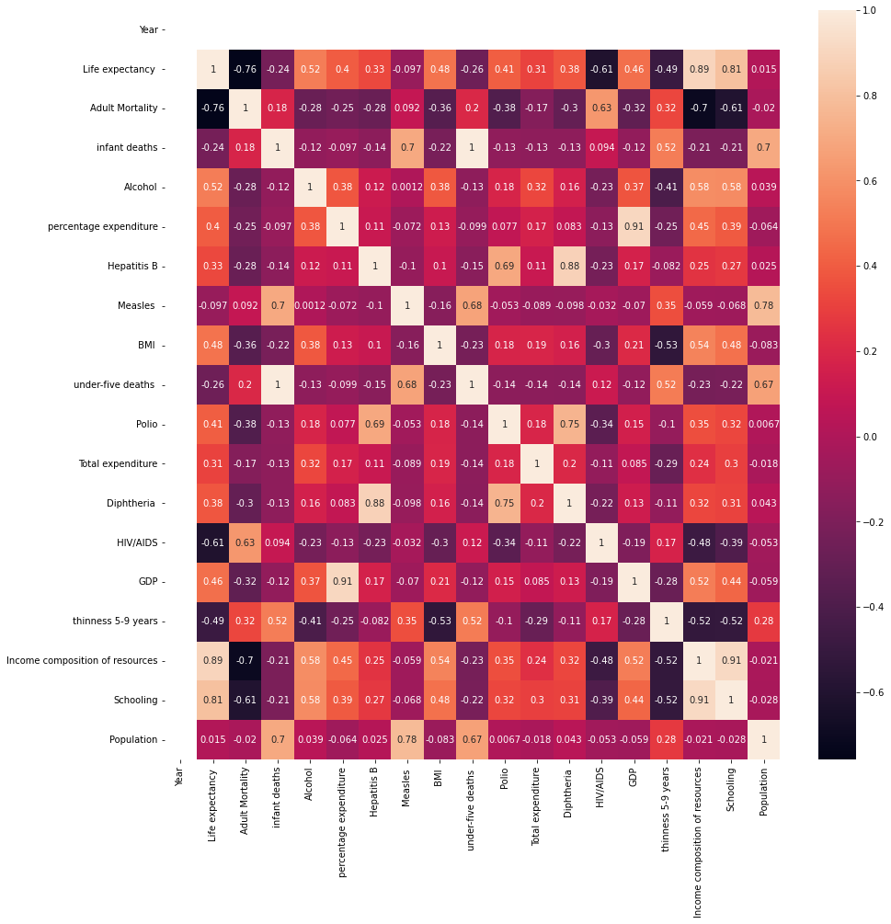
EXPLORATORY ANALYSIS – EXAMINING CORRELATION AMONG PREDICTORS

Slide 7
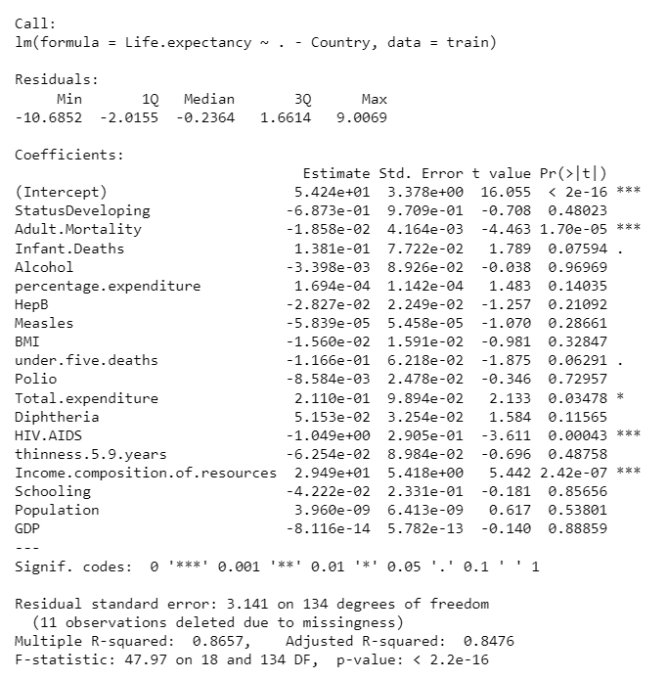
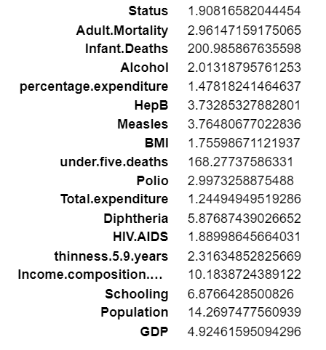
FULL MODEL - WITH HIGH MULTICOLLINEARITY
VIFs:

Slide 8
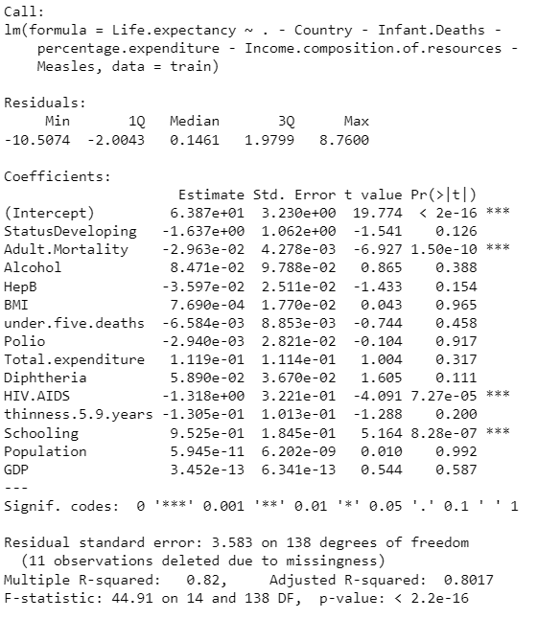
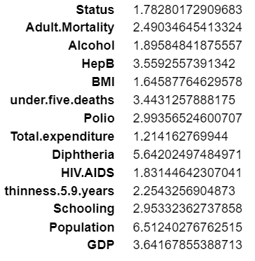
MODEL WITH REDUCED MULTICOLLINEARITY - USED CORR MATRIX AND VIF VALUES OVER SEVERAL ITERATIONS
VIFs:

Slide 9
VARIABLE SELECTION
BACKWARD STEPWISE REGRESSION:
We started out with all predictors from our previous step and, at each step, dropped the predictor which was causing the highest AIC.
We stop when AIC stops decreasing.
REMAINING PREDICTORS: (10 dropped)
Status: Developing/Developed
Adult Mortality: Probability of dying between 15 and 60 years per 1000 population
Hepatitis B: Hep B immunization coverage among 1-year-olds (%)
Diphtheria: (DTP3) immunization coverage among 1-year-olds (%)
HIV AIDS: Deaths per 1000 live births HIV/AIDS (0 - 4 years)
Thinness 5-9 years : Prevalence of thinness among children (5 – 9 years) (% )
Schooling: Average number of years of schooling

Slide 10
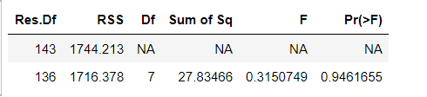

ANALYSIS OF VARIANCE
COMPARING THE REDUCED AND COMPLETE MODELS USING ANOVA:
Ho: The excluded variables are not significant
Ha: The excluded variables are significant
F statistic = 0.315
Critical F value = $F_{0.05,7,136}$ = 2.078
We fail to reject Ho and conclude that the reduced model is better!

Slide 11
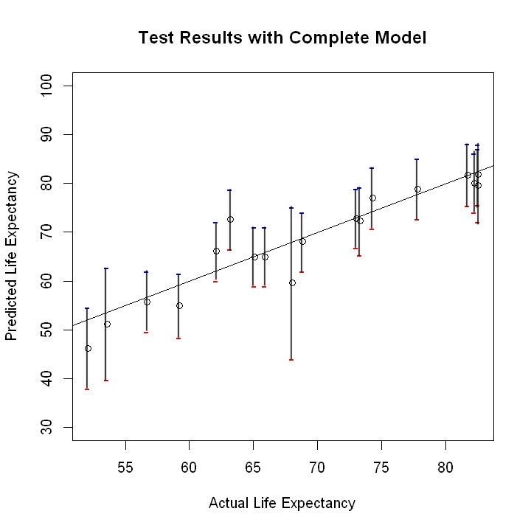
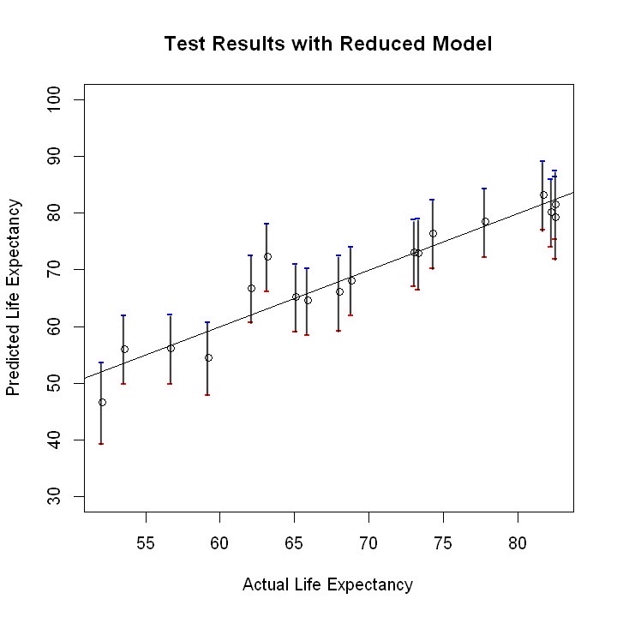
PREDICTION USING TEST DATA AND CONFIDENCE INTERVALS
RMSE: 3.80 years
RMSE: 3.27 years

Slide 12
DISCUSSIONS AND CONCLUSIONS

Slide 13
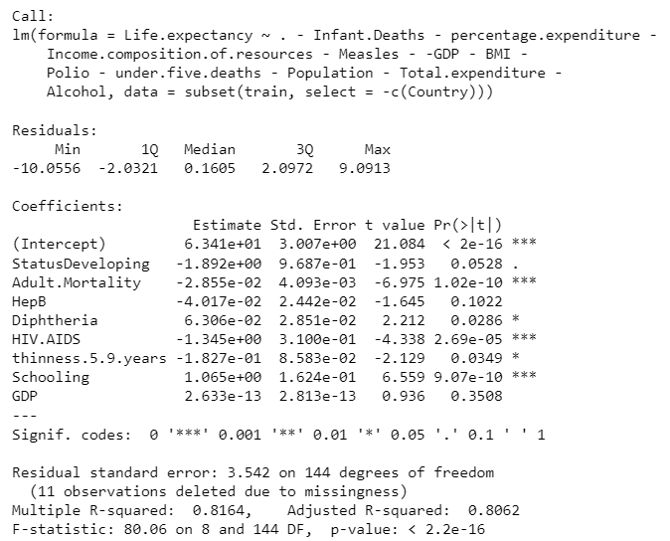
FINAL MODEL
SOME INTERESTING INTERPRETATIONS:
Developing vs Developed Nations
DTP3 vaccination
SIGNIFICANT PREDICTORS (ALPHA = 0.05):
Adult Mortality
Diphtheria
HIV/AIDS
Thinness in children of age 5 – 9 years
Schooling

Slide 14
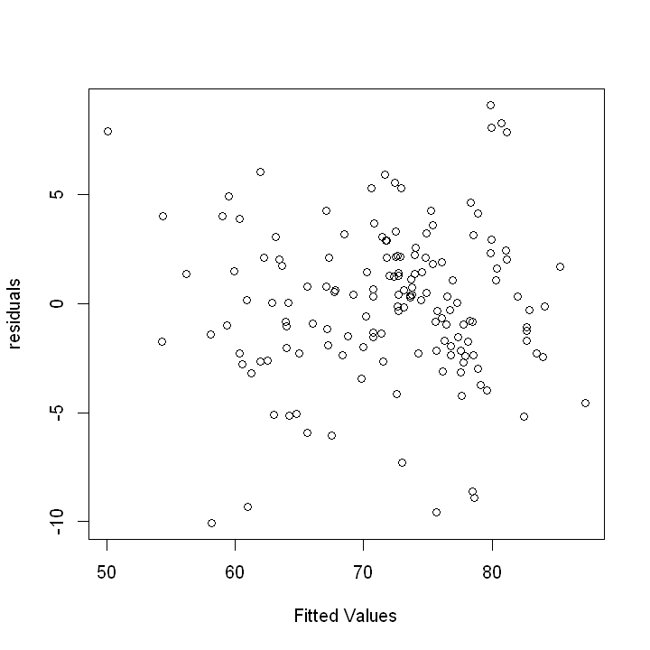
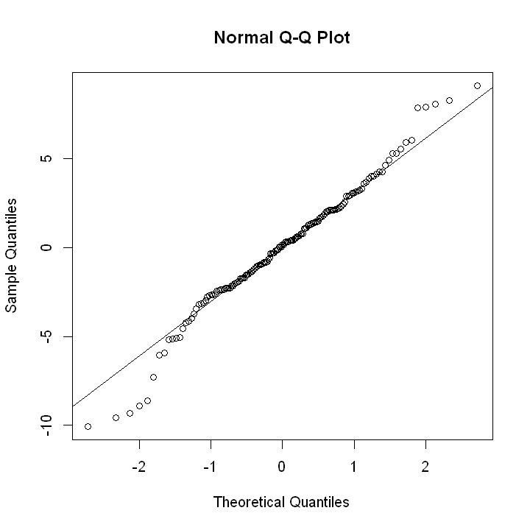
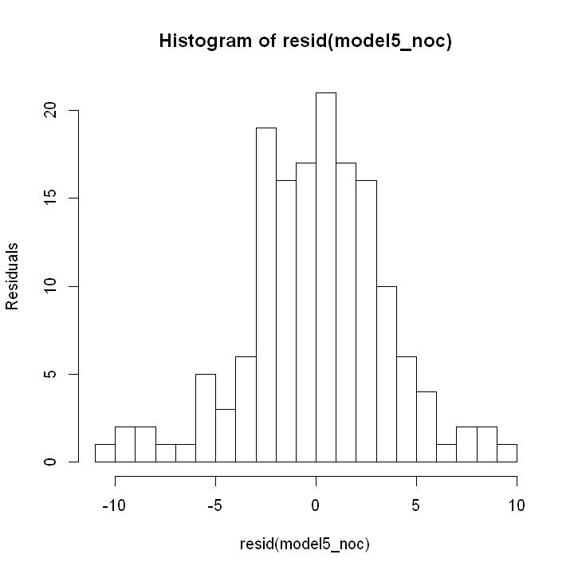
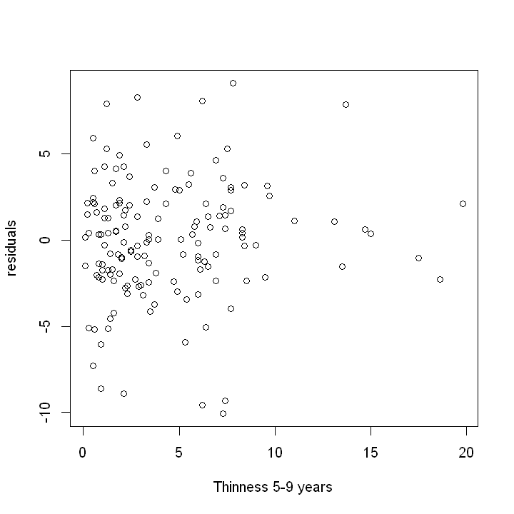
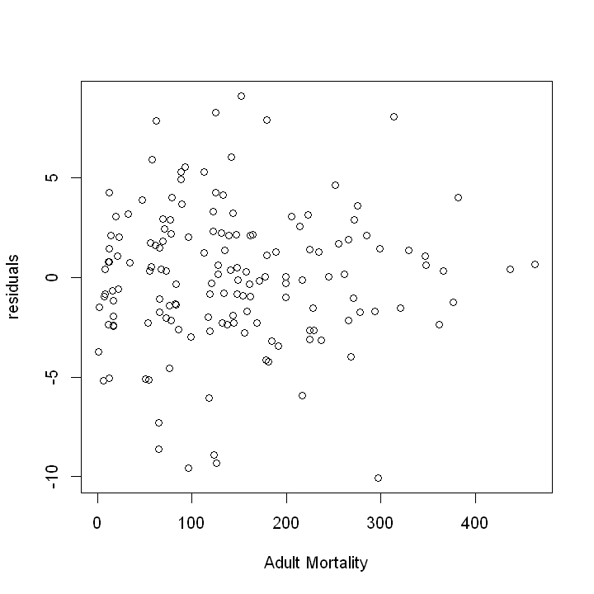
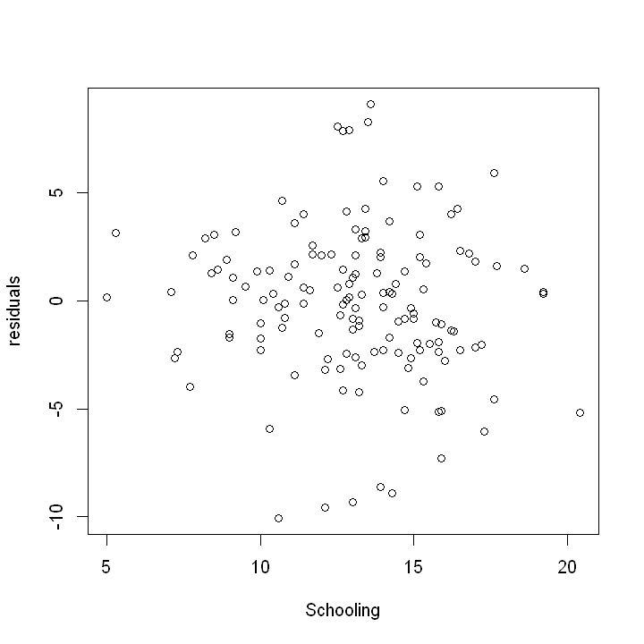
RESIDUAL ANALYSIS - FINAL MODEL
Mean of residuals ~ 0

Slide 15
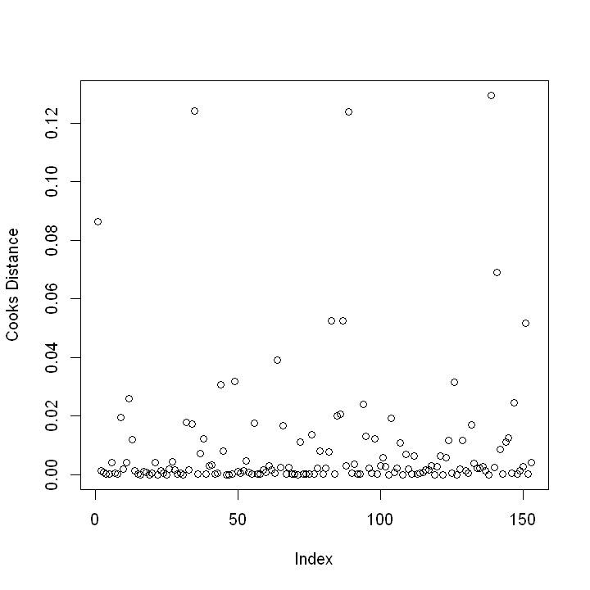
OUTLIERS
14 outliers: Cook’s distance > 4/164
Somalia, UK, Maldives, Philippines, Mauritania, Spain, Romania, Mauritius, Ethiopia, Myanmar, Bulgaria, Hungary, Togo, Tajikistan
Examining data did not reveal any obvious errors. We let the outliers remain.

Slide 16
INTERESTING CONCLUSIONS!
ESTIMATED LIFE EXPECTANCIES:
Australia : 87.39 ± 1.38 yrs (Max)
Lesotho : 48.62 ± 2.96 yrs (Min)
USA : 78.69 ± 1.51 yrs
India : 65.61 ± 2.66 yrs
At 90% confidence level!

Slide 17
Q/A
Thank you!

